Slide 1

Team Name : Cyber Kiddos
Team Leader Name : Shri Raksha K
Problem Statement : Millions of citizens in India are unaware of government schemes due to language barriers, digital illiteracy, and complex government portals .Rural and undeserved communities often fail to access benefits they are eligible for, resulting in exclusion from essential government support

Slide 2

Brief about the Idea:
BharatSathi is an AI-powered, voice-first assistant that helps citizens access government schemes in their local language.
It simplifies complex scheme information, checks eligibility using basic user details, and provides clear step-by-step guidance.
Designed for rural and digitally underserved communities, it works in low-bandwidth areas and reduces dependency on middlemen, ensuring inclusive access to government benefits.

Slide 3
Your solution should be able to explain the following:
How different is it from any of the other existing ideas?
Voice-first, multilingual AI assistant designed for rural and low-literacy users instead of complex text- based portals.
How will it be able to solve the problem?
Simplifies scheme details, checks eligibility using basic user information, and provides step-by-step guidance in local languages.
USP of the proposed solution
AI-powered eligibility checking, voice access for non-literate users, low-bandwidth support, and high social impact across India.

Slide 4
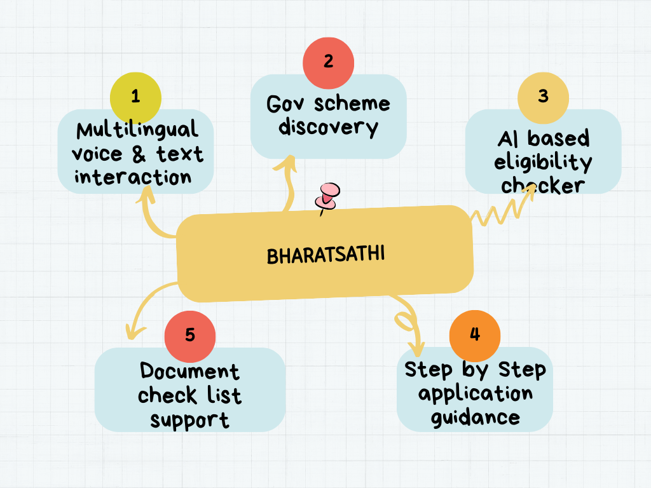
List of features offered by the solution
Features Offered by BharatSathi
Multilingual voice & text interaction
Government scheme discovery system
AI-based eligibility checker
Document checklist support
Web & WhatsApp integration
Low-bandwidth optimized access
SMS-based offline support (future scope)
Simple, accessible, and inclusive solution for all citizens.
Step by Step application guidance

Slide 5
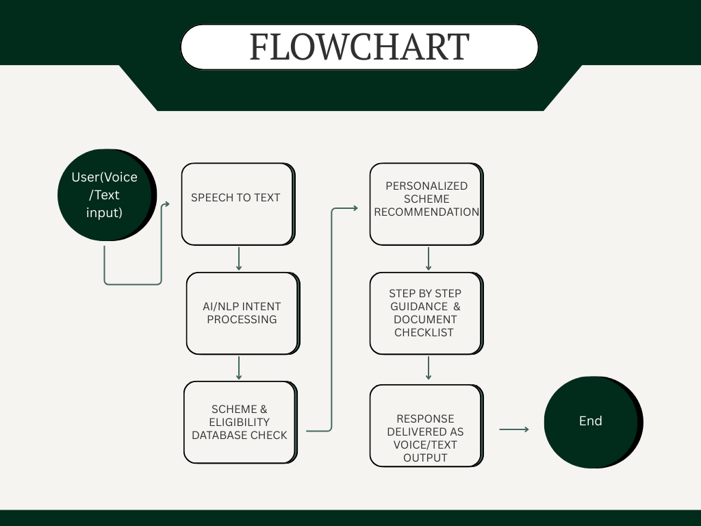
Process flow diagram or Use-case diagram

Slide 6
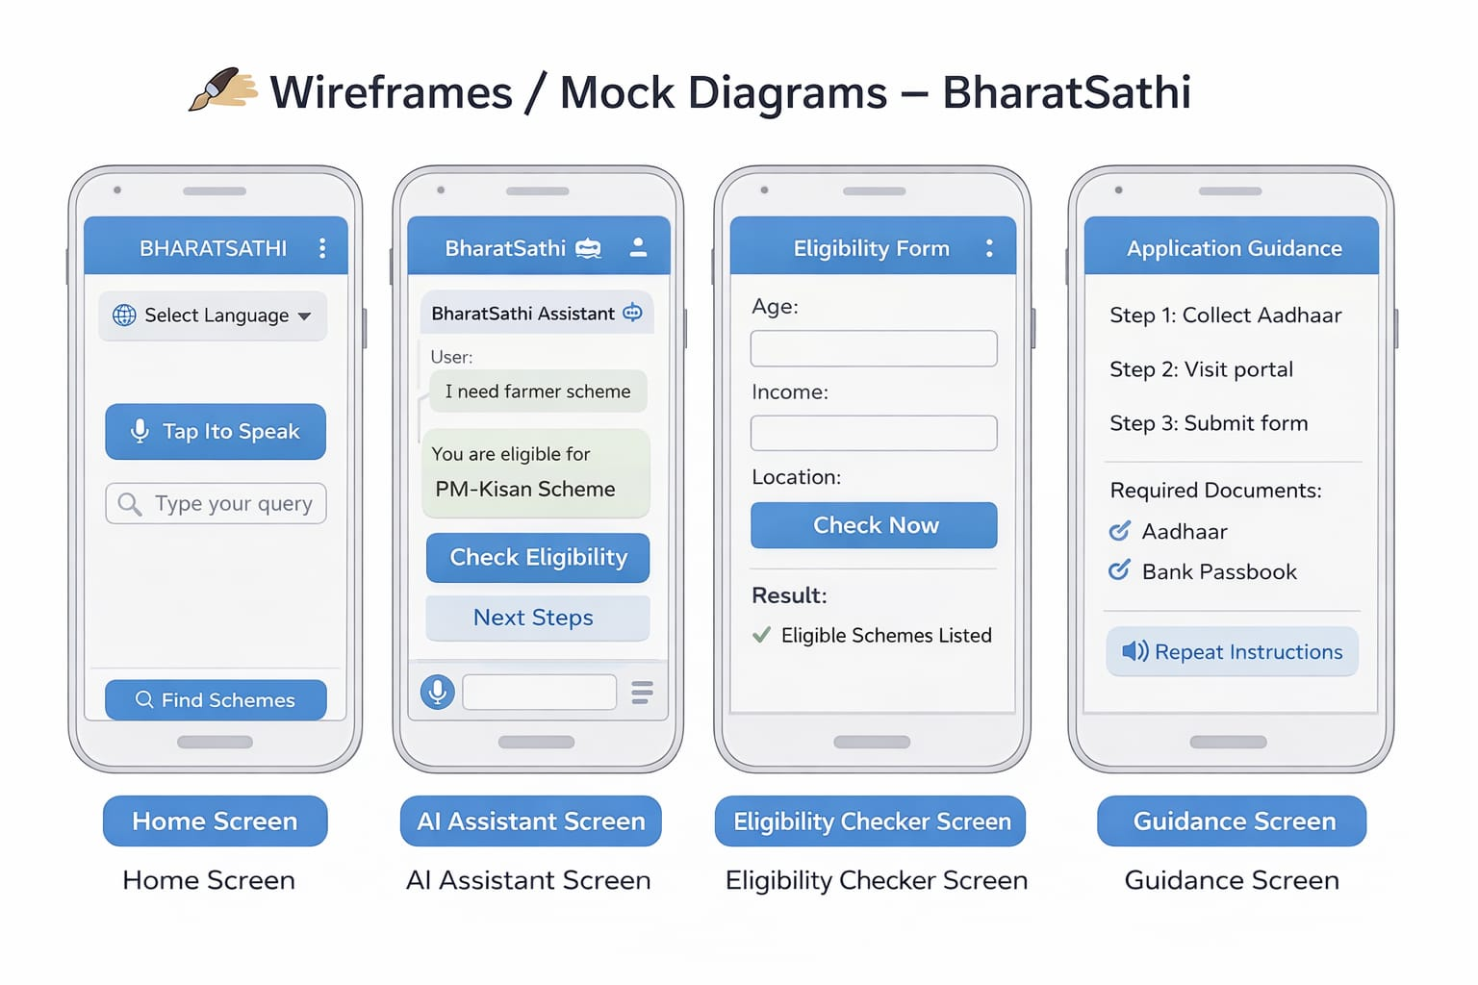
Wireframes/Mock diagrams of the proposed solution (optional)

Slide 7
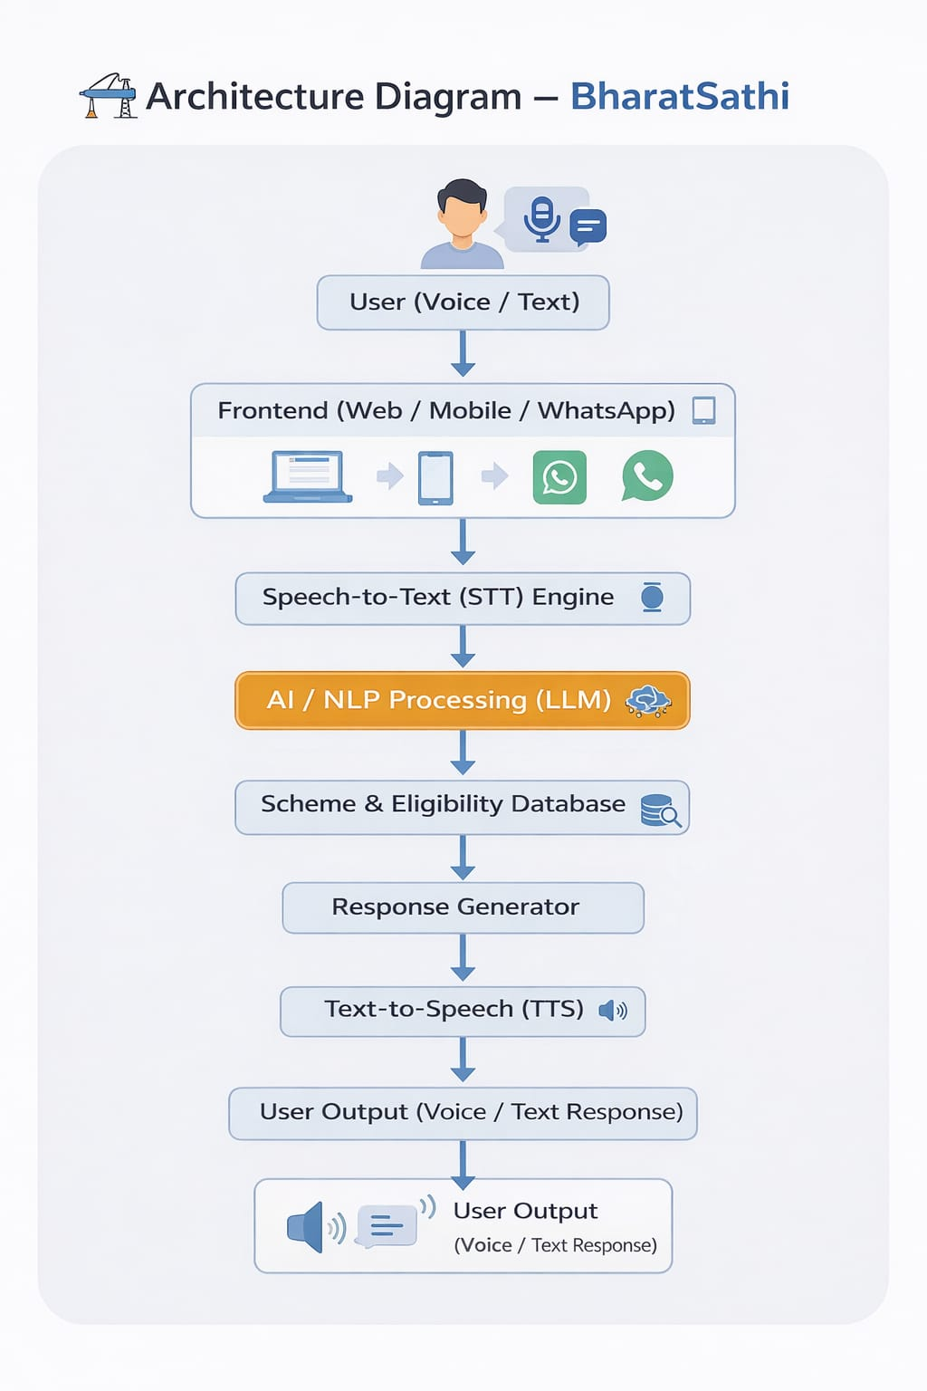
Architecture diagram of the proposed solution:

Slide 8
Technologies to be used in the solution:
Frontend : HTML, CSS, React (User-friendly web interface)
Backend : Python (FastAPI / Flask) for API development
AI / NLP : Large Language Models (LLM) for intent understanding & response generation
Speech Technologies:
Speech-to-Text (STT)
Text-to-Speech (TTS)
Database : DynamoDB / Cloud-based database for scheme & eligibility data
Cloud Platform: AWS (Lambda, API Gateway, Cloud Hosting)

Slide 9
Estimated implementation cost
Development Cost (Initial MVP):
₹1.5 – 2 Lakhs (UI, Backend, AI Integration, Testing)
Cloud & Hosting (Monthly):
₹15,000 – ₹30,000 (AWS, Database, API usage, Storage)
Speech & AI API Usage:
Based on user traffic (Scalable pay-as-you-go model)
Maintenance & Updates:
₹10,000 – ₹20,000 per month

Slide 10
Add as per the requirements for the hackathon:
Support for multiple Indian regional languages
SMS-based access for low-internet areas
Dedicated mobile application (Android)
Integration with official government portals
Personalized scheme notifications & alerts
Scalable AWS cloud deployment
Secure and privacy-focused architecture
Designed to align strongly with the AI for Bharat vision by ensuring inclusivity, scalability, and real-world social impact.

Slide 11


